Slide 1
Lecture 3: HTML + CSS
DEEP DIVE
SEMANTIC HTML
CSS

Slide 2
WIREFRAMES: Responsive Layouts
ABSTRACT PLUGIN to view css
ZEPLIN to view css

Slide 3
HTML & CSS: Design and build websites CH 2 – TEXT: http://www.htmlandcssbook.com/code-samples/chapter-02
<!DOCTYPE html>
<html>
<head>
<title>View the Source of This Page<title>
</head>
<body>
<h1>This is a <i>main</i> heading.</h1>
<h2>This is a level 2 heading</h2>
<hr/> (I am a horizontal rule.) -----------------------------------------------
<h3>This is a level 3 heading</h3>
<p>This is a <b>BOLD</b> paragraph</p>
<blockquote cite="http://en.wikipedia.org/wiki/Winnie-the-Pooh">
<p>Did you ever stop to think, and forget to start again?</p>
</blockquote>
<p>As A.A. Milne said, <q>Some people talk to animals. Not many listen though. That's the problem.</q></p>
</body>
<html>

Slide 4
HTML & CSS: Design and build websites CH 3 – LISTS: http://www.htmlandcssbook.com/code-samples/chapter-03
<ul>
<li>1kg King Edward potatoes</li>
<li>100ml milk</li>
<li>50g salted butter</li>
<li>Freshly grated nutmeg</li>
<li>Salt and pepper to taste</li>
</ul>
<!DOCTYPE html>
<html>
<head>
<title>View the Source of This Page<title>
</head>
<body>
<ol>
<li>Chop potatoes into quarters</li>
<li>Simmer in salted water for 15-20 minutes until tender</li>
<li>Heat milk, butter and nutmeg</li>
<li>Drain potatoes and mash</li>
<li>Mix in the milk mixture</li>
</ol>
</body>
<html>
<ul>
<li>Mousses</li>
<li>Pastries
<ul>
<li>Croissant</li>
<li>Mille-feuille</li>
<li>Palmier</li>
<li>Profiterole</li>
</ul>
</li>
<li>Tarts</li>
</ul>

Slide 5
HTML & CSS: Online Code Editors & Validators
ONLINE CODE EDITORS
CodePen (https://codepen.io)
JS Bin (https://jsbin.com/)
JSfiddle (https://jsfiddle.net)
W3C Validators check markup validity
W3C HTML Validator (https://validator.w3.org)
W3C HTML5 Validator (https://validator.w3.org/nu/)
W3C CSS Validator (https://jigsaw.w3.org/css-validator/)

Slide 6

HTML & CSS: CodePen Video

Slide 7
HTML & CSS: JS Bin Video

Slide 8
HTML: Last Week Review
Paper Prototypes & Wireframes: Keep Working on your paper prototypes and wireframes to absolute perfection so we are NOT designing and coding at the same time!
Upload your final paper prototype design AND Sketch wireframes to CANVAS: HOME, ABOUT, DISCOGRAPHY. Due today for grading.
HTML: Hyper Text Markup Language
Think of as a Skeleton or Body
Holds everything together
CSS: Cascading Style Sheets
Think of as Clothes
Styling of website or rather the presentation
Style classes cascade through every html page to simultaneously change the style of elements.

Slide 9
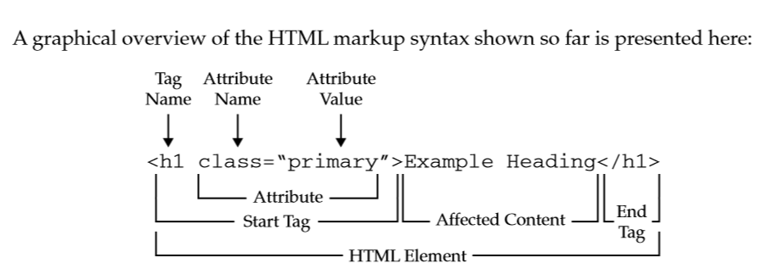
HTML: Tag / Element Breakdown

Slide 10
HTML: Experiment with Tags
Let’s together start writing some tags and watch what happens in the browser
Headers: h1 - h6
Paragraph: p
Span: span
Anchor: a
Image: img
Unordered Lists: ul
Ordered Lists: ol
You will notice that some elements render on new lines and other elements render inline. This concept is Inline vs Block Level Elements
Inline Elements:
Do not start on a new line
Only as wide as needed
Block Elements
Start on new line
Full width
Full list of Inline and Block Elements

Slide 11
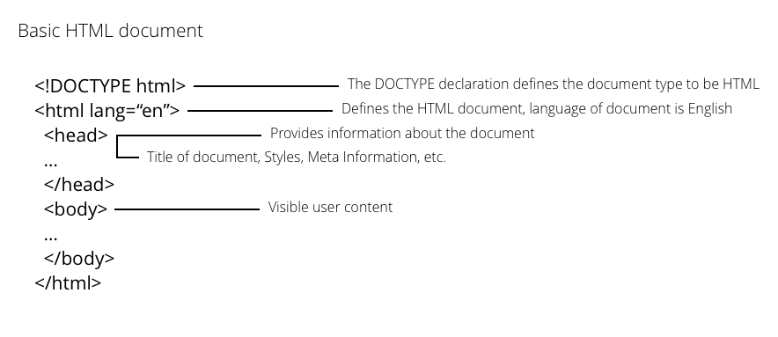
HTML: Document
HTML documents have a few HTML tags that are required
<!DOCTYPE>
<html>
<head>
<body>

Slide 12


Slide 13
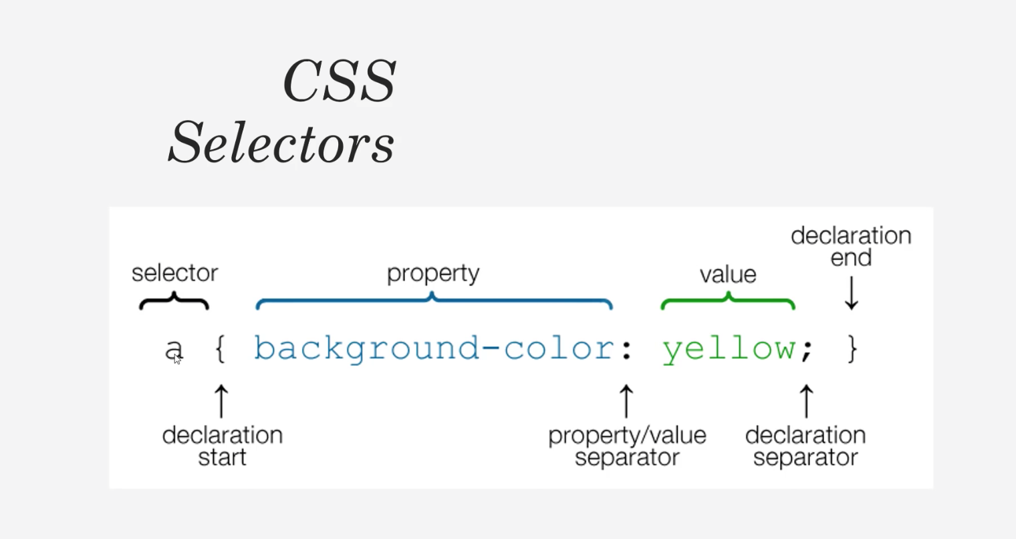
How the CSS Works
VIDEO LINK

Slide 14
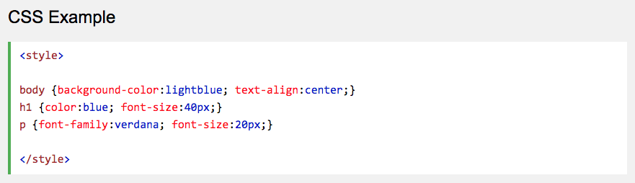
CSS: What is it?
CSS stands for Cascading Style Sheets.
CSS describes how HTML elements are to be displayed.

Slide 15
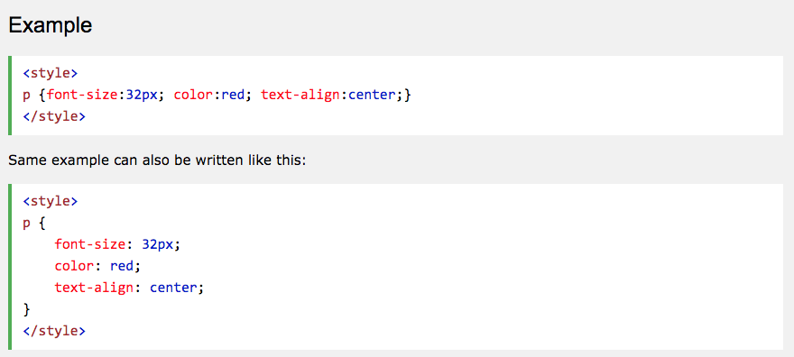
CSS

Slide 16
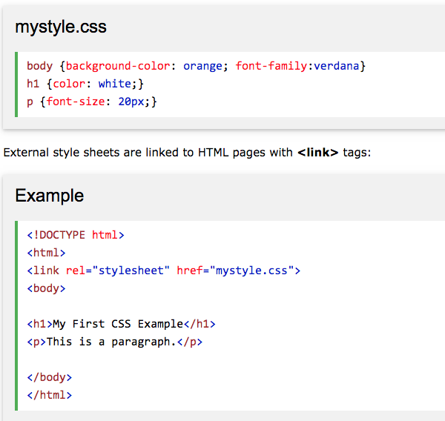
CSS: External stylesheet: css /stylesheet.css

Slide 17
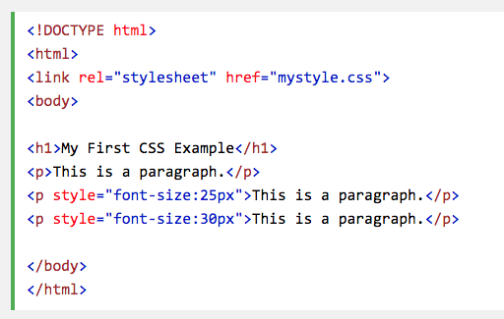
CSS: Inline Styles

Slide 18
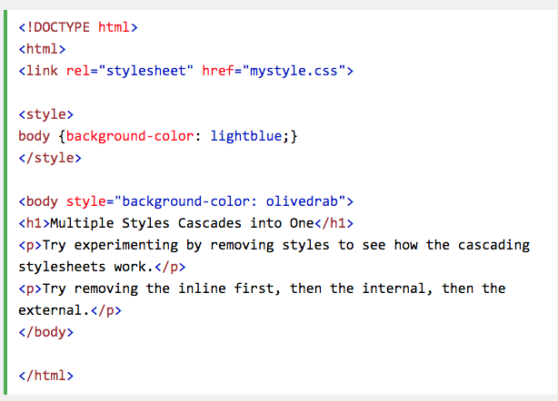
CSS: Cascading Order
If different styles are specified
for HTML elements, the styles will cascade into new styles with the following priority:
Priority 1: Inline Styles
Priority 2: External and internal style sheets
Priority 3: Browser default
If different styles are defined on the same priority level, the last one has the highest priority.
https://www.w3schools.com/whatis/whatis_css.asp

Slide 19
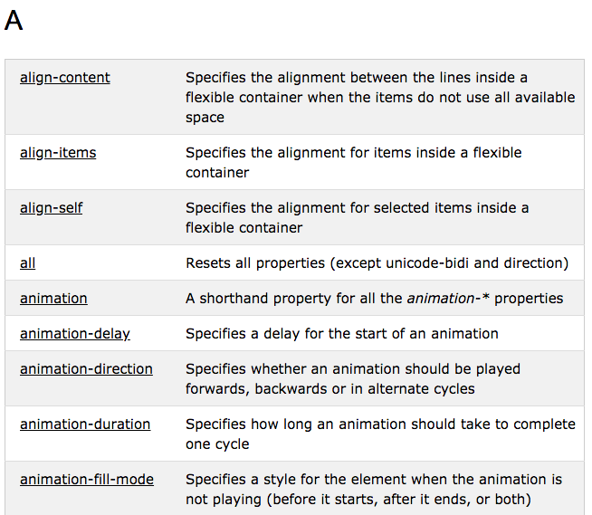
CSS: Full Reference Guide
https://www.w3schools.com/cssref/default.asp
CSS VIDEO

Slide 20
CSS Exercices and Examples
Let's test our CSS chops
Let's take a CSS quiz

Slide 22
CSS: Full Reference Guide
https://www.w3schools.com/cssref/default.asp
CSS VIDEO

Slide 23
CSS: OVERVIEW
CSS Backgrounds
CSS Borders
CSS Margins
CSS Padding
CSS Height / Width
CSS Box Model
CSS Outline
CSS Text
CSS Fonts
CSS Icons
CSS Links
CSS Lists
CSS Tables
CSS Display
CSS Navigation Bar

Slide 24
CSS: Navigation Bar

Slide 25
HTML: Week 3 Homework
Homework
Read: Ch 7,8,9
Wireframes
Media
Merch
Tour Dates
Practice Coding
Make an index.html file
Practice tags
Use attributes on your tags
Lists, Paragraphs, Headers
Test out Atom Plugins and Themes

